Slide 1
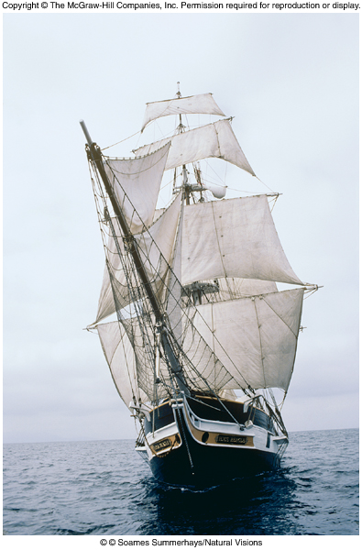
The Science of Biology
Chapter 1

Slide 2
Properties of Life
Living organisms:
are composed of cells
are complex and ordered
respond to their environment
can grow and reproduce
obtain and use energy
maintain internal balance/homeostasis
allow for evolutionary adaptation

Slide 3
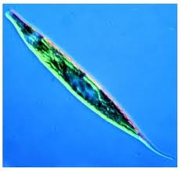
Characteristics of Living Things.
1. Cellular Organization or Made up of cells. One cell ( unicellular) or many cells (Multicellular)
  Eukaryotic – true nucei
  Prokaryotic – before nucei
2. Ordered Complexity. All living things are both complex and Highly ordered.

Slide 4
3. Grow and Develop Reproduce: Make new cells or new offspring.
A. Asexual Reproduction. Cells divide to form new cells.
B. Sexual Reproduction: New Organisms reproduce from two parent organisms.
*Both animals and some plants reproduce this way.

Slide 5
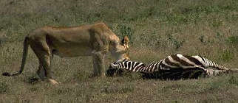
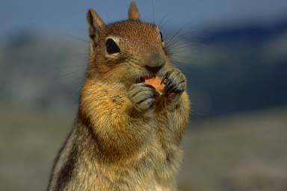
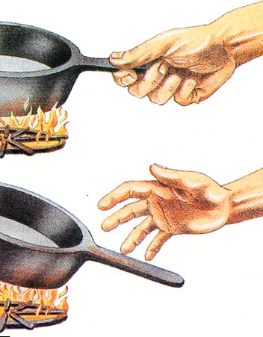
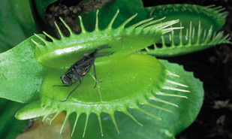
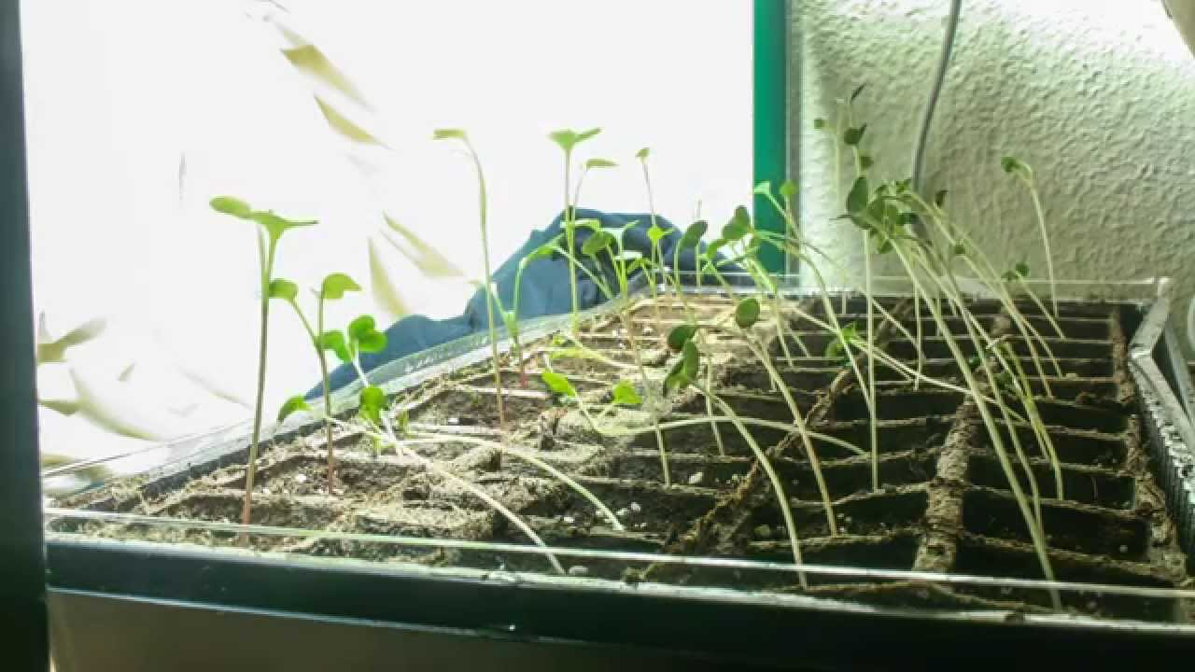
4. Energy utilization or Obtain and use energy. To give off heat, move and allow cells to grow and develop
5. Sensitivity to stimuli or Respond to their environment. To allow the organism to move and interact with other organism in their environment.
Could be flight, attack, talk or any other gestures.

Slide 6
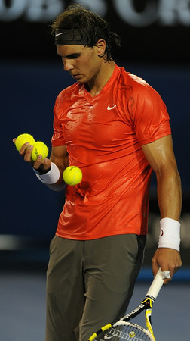
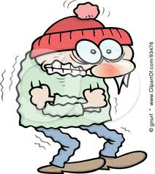
6. Homeostasis: All organisms maintain constant internal conditions that are different from their environment.

Slide 7
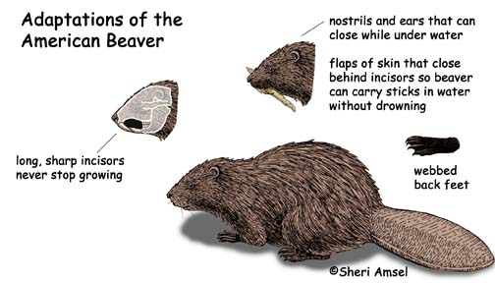
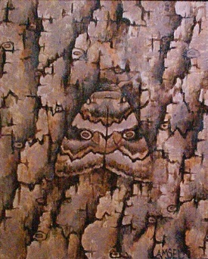
7. Evolutionary adaptation: All organisms interact with biotic and abiotic factors. These factors influence their survival, and adaptations.

Slide 8
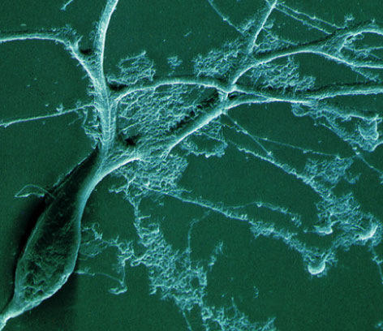
Levels of Organization
Cellular Organization
cells
organelles
molecules
atoms
The cell is the
basic unit of life.

Slide 9
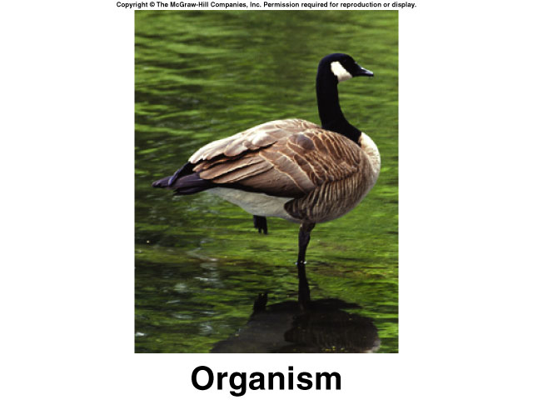
Levels of Organization
Organismal Level
organism
organ systems
organs
tissues

Slide 10
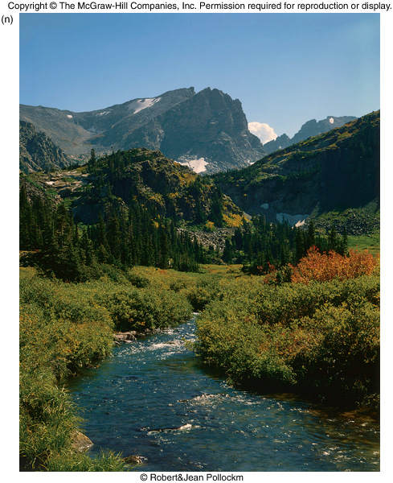
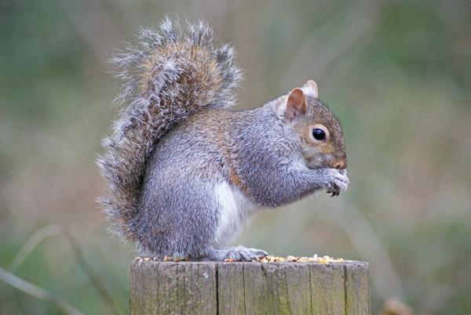
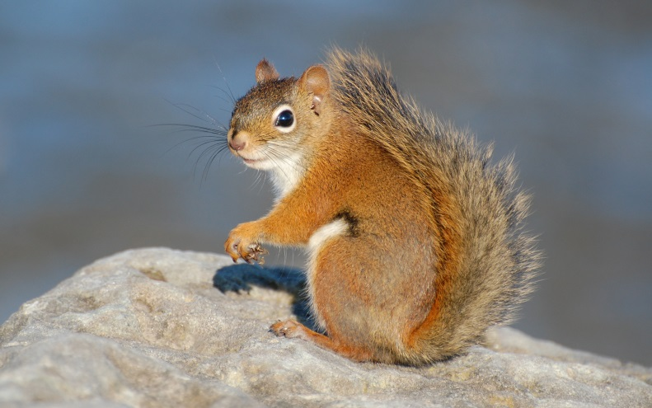
Levels of Organization
Population Level
ecosystem
community
species/speciation
population
Sciurus vulgaris
Sciurus carolinenis

Slide 11
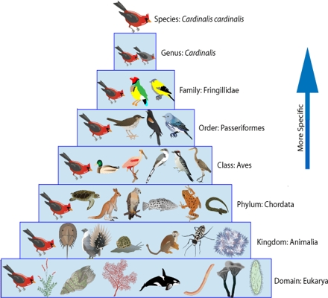
Taxonomy
This is a way of placing organisms into categories.
It starts as very General characteristics and then leads to more specific characteristics.

Slide 12
Taxonomy
Domains 3 Kingdoms: 6
Plant, Animal, Protist, Fungi, Bacteria, and Archea.
Domain: Eukarya Eukarya
Kingdom: Animalia Animalia
Phylum : Chodata Chordata
Class: Mammalia Mammalia
Order: Rodentia Primate
Family: Sciuridae Hominidae
Genus: Sciurus Homo
Species: carolinenis sapien

Slide 13
Sciurus carolinenis
Sciurus vulgaris

Slide 14
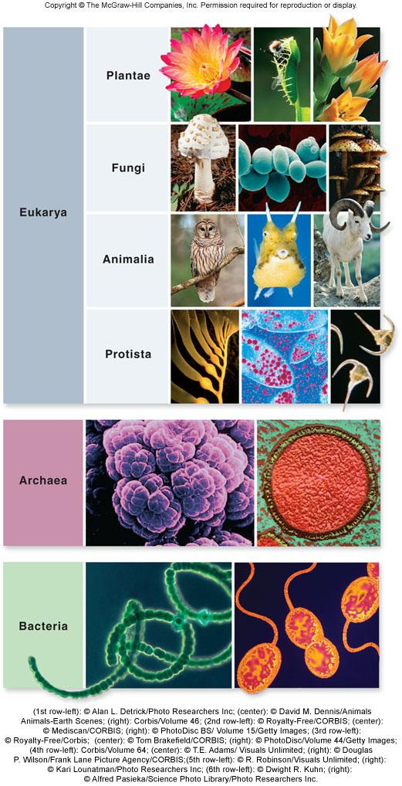
3 Domain and 4 Kingdom system was first started by Woese.
He also came up with the 6 Kingdom System.

Slide 15
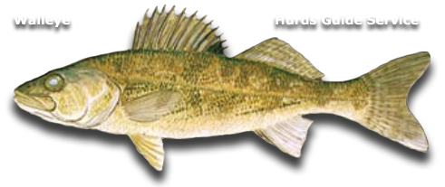
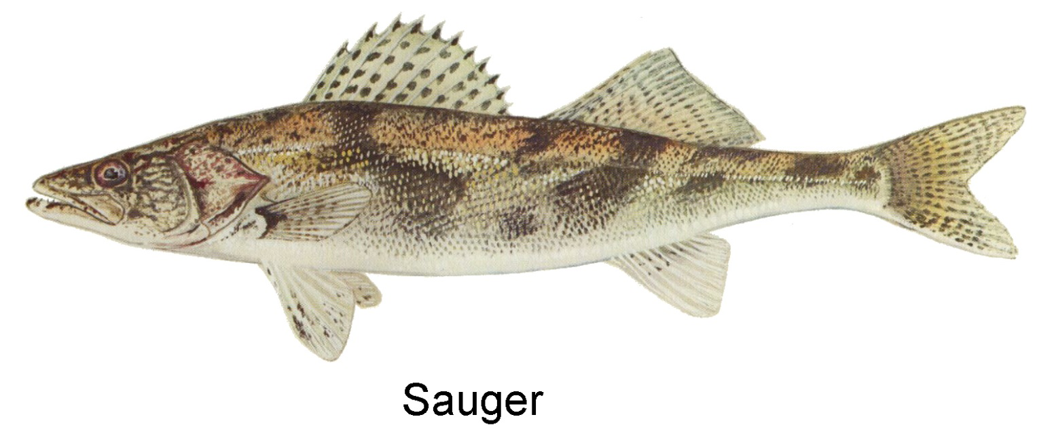
Sander
vitrieus
Sander
canadensis

Slide 16
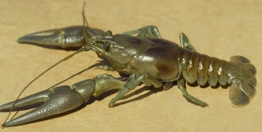
Orconectes rusticus)

Slide 17
Levels of Organization
Each level of organization builds on the level below it but often demonstrates new features.
Emergent properties: new properties present at one level that are not seen in the previous level

Slide 18
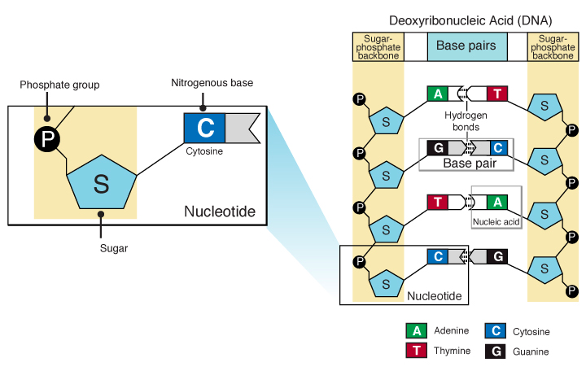
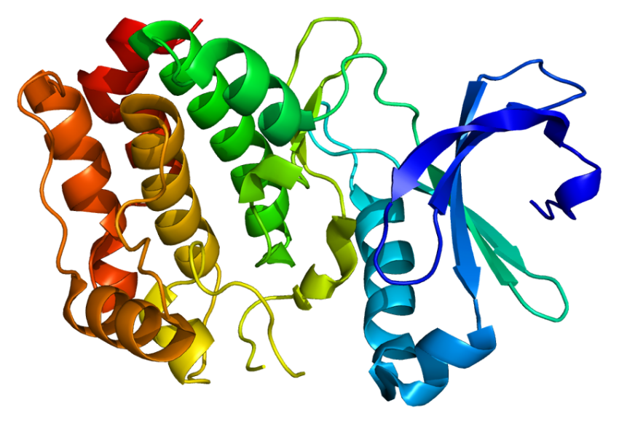
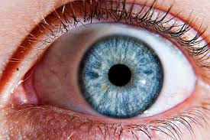


Slide 19
Ecosystem Emergent property
At the ecosystem level, each organism interacts with other organisms
These interactions may be beneficial or harmful to one or both of the organisms
Organisms also interact continuously with the physical factors in their environment, and the environment is affected by the organisms living there

Slide 20
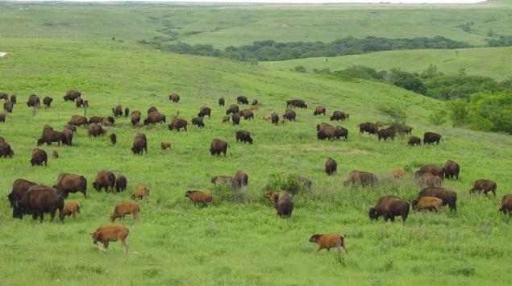
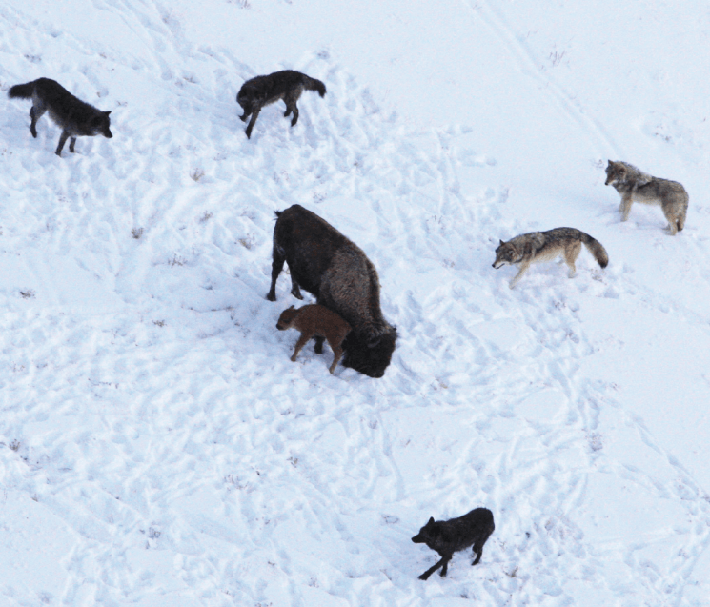

Slide 21
Unifying Themes in Biology
Evolutionary change
- Living organisms have evolved from the same origin event. The diversity of life is the result of evolutionary change.
Evolutionary conservation
- Critical characteristics of early organisms are preserved and passed on to future generations.

Slide 22
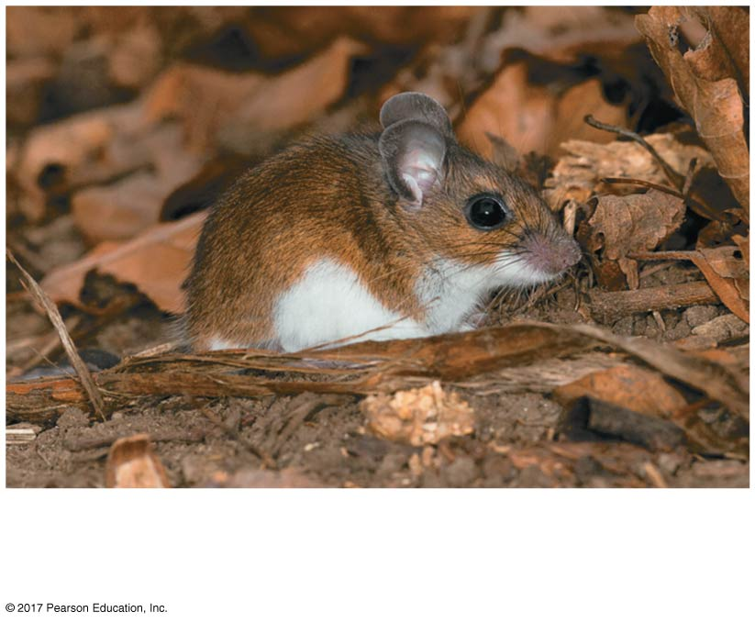
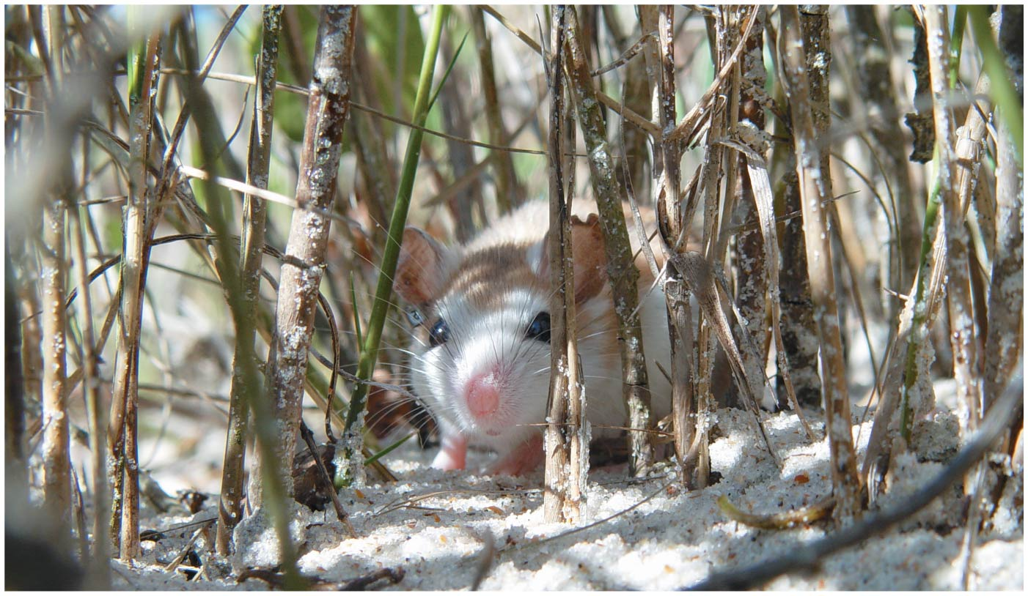
An inland mouse of the species
Peromyscus polionotus
A beach mouse of the same species
© 2017 Pearson Education, Inc.
Notes:
Figure 1.1 What can this beach mouse (Peromyscus polionotus) teach us about biology?

Slide 23
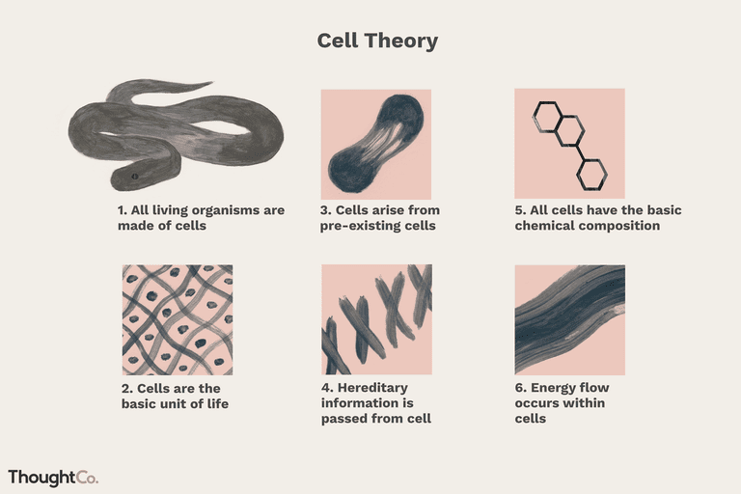
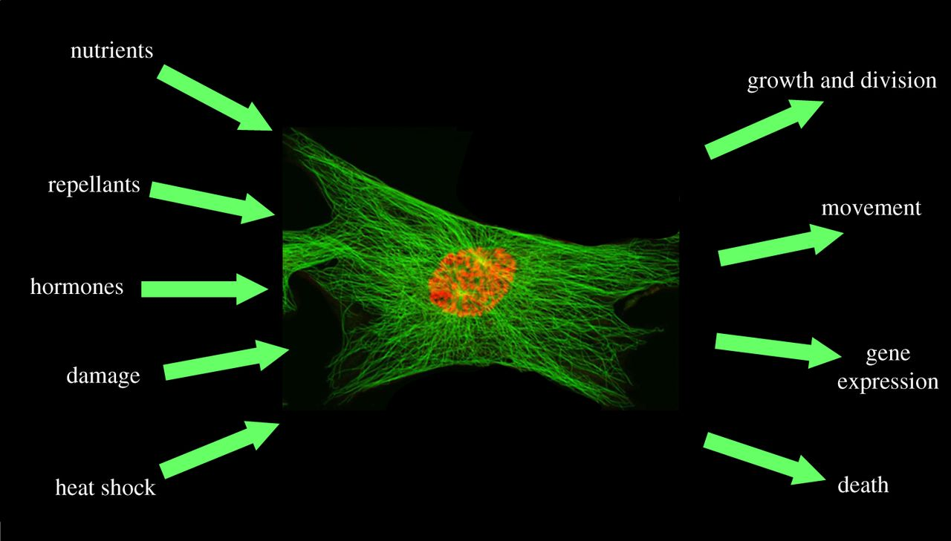
Unifying Themes in Biology
Cell theory
All living organisms are made of cells, and all living cells come from preexisting cells.
Cells - information processing systems
- Cells process information stored in DNA as well as information received from the environment.

Slide 24
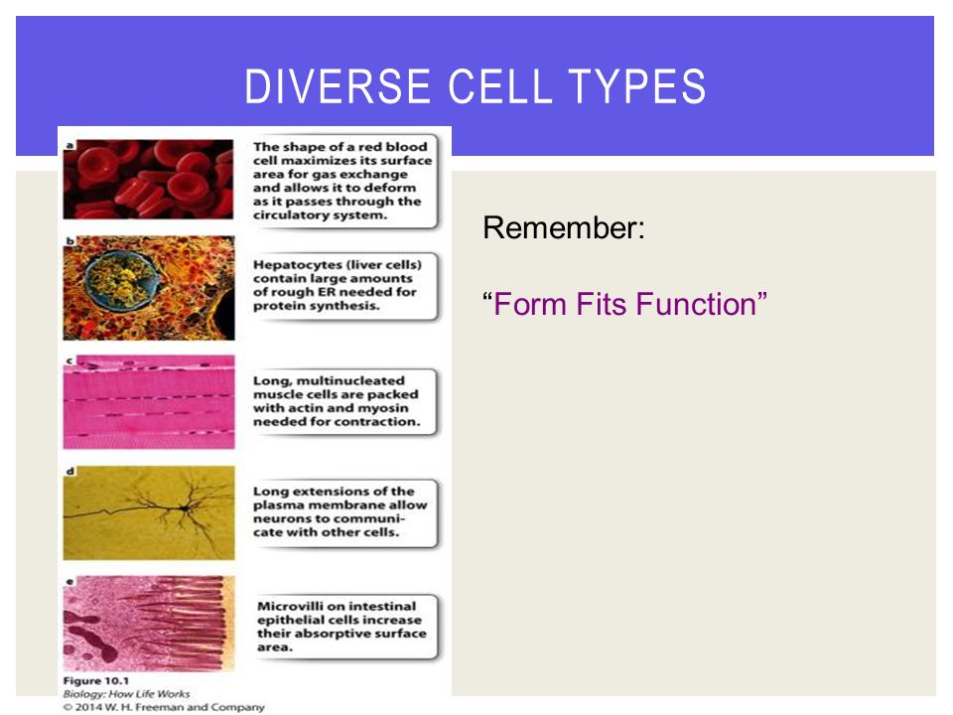
Unifying Themes in Biology
Structure and Function
-The proper function of a molecule is dependent on its structure.
-The structure of a molecule can often tell us about its function.
Molecular basis of inheritance
- DNA encodes genes which control living organisms and are passed from one generation to the next.

Slide 25
Unifying Themes in Biology
Energy
The input of energy from the sun and the transformation of energy from one form to another make life possible
When organisms use energy to perform work, some energy is lost as heat
  energy flows through an ecosystem, usually entering as light and exiting as heat
Chemicals cycle within an ecosystem, where they are used and then recycled

Slide 26
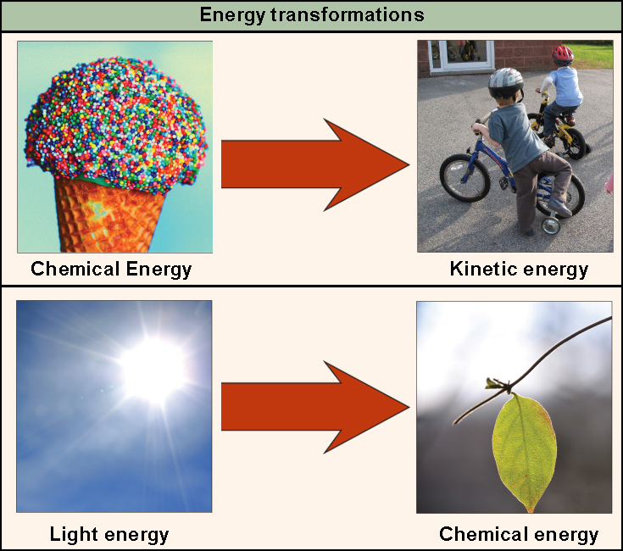
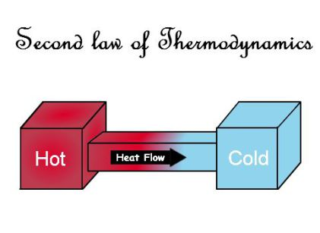
First law of thermodynamics
  Energy cannot be created or destroyed only changed in form.
Second law of thermodynamics
  Everything in the universe flows from order to disorder
    Energy must be inputted to gain order
    Where one is lost one is gained

Slide 27
The Nature of Science
Science aims to understand the natural world through observation and reasoning.
Science begins with observations, therefore, much of science is purely descriptive.
Science uses both deductive and inductive reasoning.

Slide 28
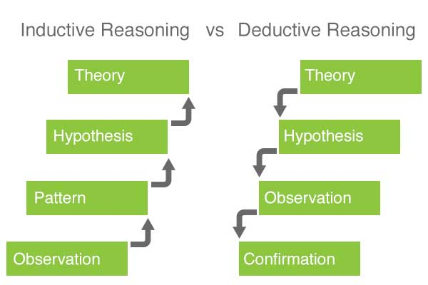
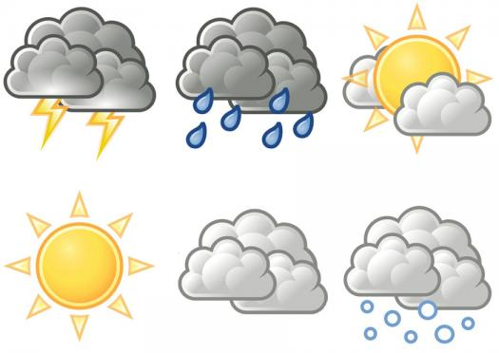
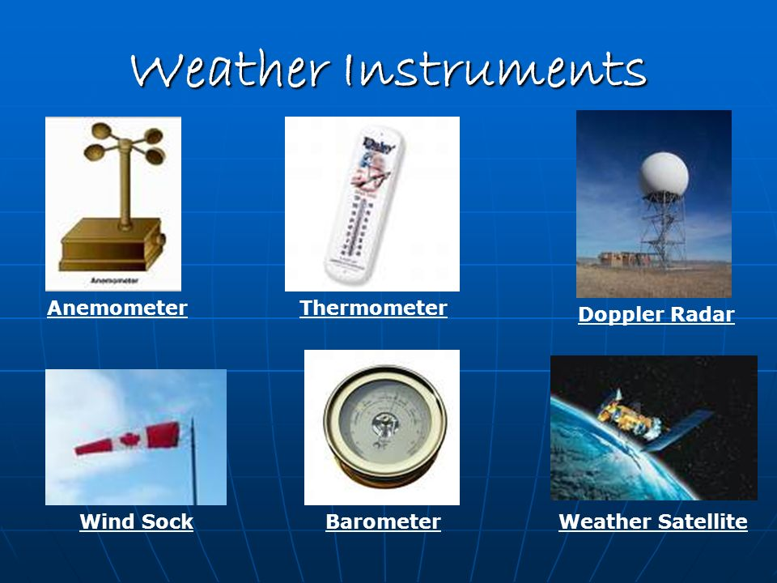
The Nature of Science
Deductive reasoning: uses general principles to make specific predictions.
Inductive reasoning: uses specific observations to develop general conclusions.

Slide 29
The Nature of Science
Scientists use a systematic approach to gain understanding of the natural world.
-Observation
-Hypothesis formation
-Prediction
-Experimentation
-Conclusion

Slide 30
The Nature of Science
A Hypothesis is a possible explanation for an observation based on something
  Only reject or accept hypothesis through experimentation
  Do not prove or become fact
-must be tested to determine its validity
-is often tested in many different ways
-allows for predictions to be made

Slide 31
Null Hypothesis
when the independent variable will not have an affect on the outcome of the experiment
  I believe that adding sugar will have no effect on the growth of plants
Use this to get rid of experimental bias

Slide 32
The Nature of Science
The experiment
-tests the hypothesis
-must be carefully designed to test only one independent variable at a time
-consists of a test experiment and a control experiment

Slide 33
Experimental Design
Independent (manipulated) variable – the factor being changed/tested
Dependent (responding) variable – the factor that may change as a result of independent variable
    What you want to measure/observe
Constant – remains same in every experiment

Slide 34
Data
Information gathered during an experiment
  Qualitative – observations
  Quantitative – numbers
Conclusion: statement that accepts or rejects the hypothesis
  Support with data
    Claim, evidence, reasoning
  Make recommendations for further study, improvements, errors

Slide 35
The Nature of Science
If the hypothesis is valid, the scientist can predict the result of the experiment.
Conducting the experiment to determine if it yields the predicted result is one way to test the validity of the experiment.

Slide 36
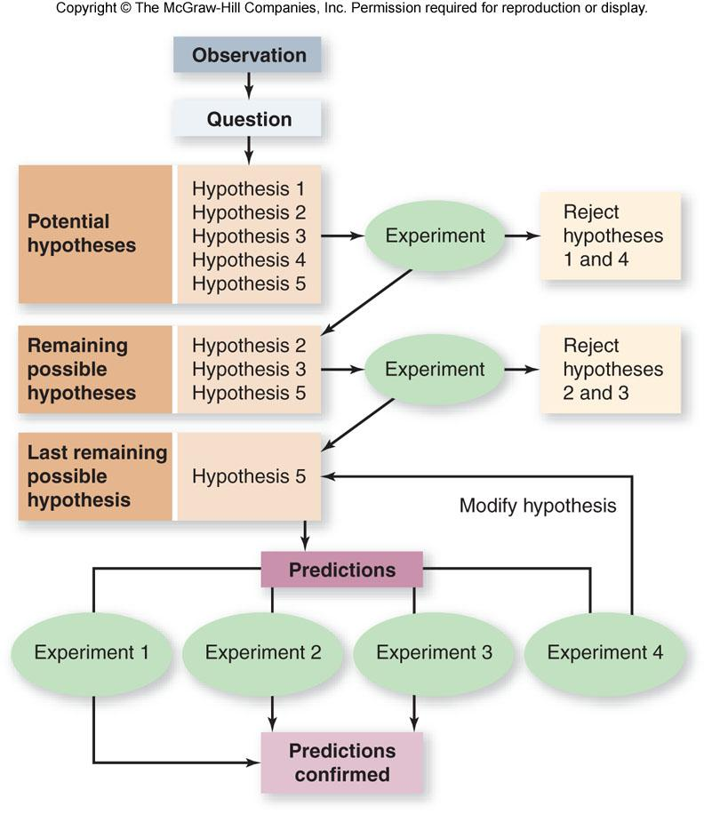

Slide 37
The Nature of Science
Scientists may use
reductionism - to break a complex process down to its simpler parts
models – to simulate phenomena that are difficult to study directly

Slide 38
The Nature of Science
Theories are not laws because they can have small variations as new advancements in measurements are made.
However the Major Concepts and Ideas will remain intact.

